Slide 1
Annual Interagency Accessibility Forum
Accessibility: A Foundation for Inclusion, Diversity, and Equity
October 12-14, 2021
Inclusive Design Demands Inclusive User Research​: How to develop equitable research and testing opportunities​
Alcora Walden, IRS Online Services; Ronna ten Brink, MITRE Corporation

Slide 2
Our Presentation Today
We’ll be talking about:
Background and motivations
The Inclusive Research capability maturity model and roadmap we’re developing
Some practical tips for conducting user research with participants with disabilities (PWD)

Slide 3
Background
IRS Online Services (OLS) is the digital touchpoint for the millions of Americans that IRS serves
OLS realized that underrepresented populations aren’t explicitly included in the R&D process
So, OLS is building an inclusive user research and usability capability to expand research opportunities to new and diverse taxpayer populations
Current focus: Identifying and prioritizing research and feedback opportunities for taxpayers with disabilities and taxpayers with limited English proficiency

Slide 4

The Inclusive Design Mindset
Inclusive Design is a methodology, born out of digital environments, that enables and draws on the full range of human diversity. Most importantly, this means including and learning from people with a range of perspectives.
- Microsoft Inclusive Design

Slide 5
Accessibility Beyond Compliance
Accessibility isn’t a checklist. Inclusive Research isn’t the same as standards compliance.
Creating an Inclusive Research capability isn’t the same as creating an Accessibility capability
Why research with people with disabilities?
Support building accessibility in from the start
Diversify participants
Increase usability for all

Slide 6



Initial Goals
Provide the wider IRS with
Targeted user research and usability evaluation
Expertise in design and evaluation in accessibility, multilingual services and Inclusive Design
Monitor and increase the participation rate of target populations in OLS user and usability research
Identify and prioritize target applications, services and web content for usability research with target populations
Notes:
Icon attribution: Monitoring by Juicy Fish from the Noun Project. Solution by Juicy Fish from the Noun Project. Action plan by Juicy Fish from the Noun Project.

Slide 7
Growing Research Capabilities
We’re in the early stages of a multi-year process!
Let’s innovate to push the intersection of government UX and Accessibility forward
We welcome ideas, feedback, and collaboration
Usability and accessibility are twins separated at birth. Same goals but like two brothers in a fable, they took different paths… What happens when these two meet? Can we get deep insights and great power?
- Whitney Quesenbery, Better Accessibility Needs User Research (2015)

Slide 8
Inclusive Research Capability Maturity Model and Roadmap

Slide 9
Deliberately Growing our Inclusive Research Capability
A piecemeal approach to inclusivity and accessibility can lead to inconsistent results, inefficient processes, difficulty securing needed resources, and unsustainable resources.
We’re creating an Inclusive Research Capability Maturity Model to:
Measure and track the degree of maturity OLS reaches in managing and implementing inclusive research
Identify future long- and short-term objectives and success metrics

Slide 10
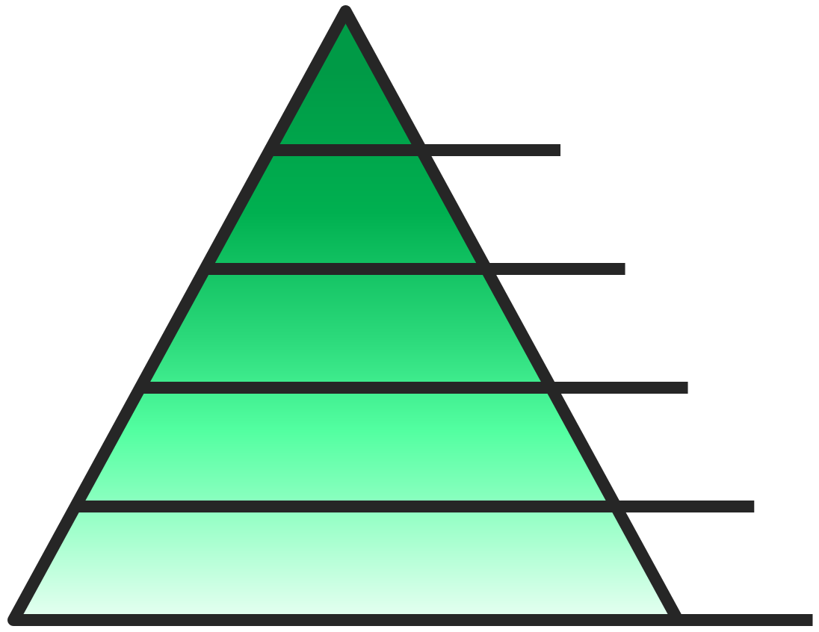
Inclusive Research Capability Maturity Levels
Level 1: Initial

Slide 11
A Roadmap to Climb the Maturity Model
An associated roadmap will lay the path for how we’ll grow our capabilities, and help to:
Define the timeline
Determine scope and progress metrics
Articulate tasks-to-be-done and milestones along the timeline
Identify dependencies, risk factors, and what resources will be needed
Strategize for handling risk and ensuring the right resources are available
We’re currently scoping for 5 years.

Slide 12

Roadmap Subsets
Operationalized research
Contractors & procurement
Workforce
Sustainability
Established community
Overview

Slide 13
Roadmap Subset Details, 1/2
Operationalized Research
Contractors & Procurement
Workforce
Planning, recruiting, collecting data, analysis, reporting
Ethics, etiquette, interpretation, communication
Accessible prototypes and study materials
Accountability
Building Inclusive Research into requirements
Setting accountability mechanisms
Equipping OLS researchers, designers, and management with Inclusive Research and accessibility skill sets
Recruiting staff to bring further expertise to the team

Slide 14
Roadmap Subset Details, 2/2
Sustainability
Established Community
Overview
Getting buy-in on Inclusive Research and accessibility
Securing sustainable resourcing
Assigning ownership
Ensuring sustainability despite organizational change
Creating relationships across organizations and agencies with others interested in Inclusive Design, accessibility, and user research (and multilingual)
Sharing knowledge and resources where possible
Regularly measuring, auditing, and strategizing
Creating accountability goals and consequences
Handling auditing and remediation (of research practices and resources)
Identifying and managing future risk
Updating the Roadmap as needed – this is a living document!

Slide 15

Roadmap Metrics
What gets measured, gets done
Outcomes (Impact): How this will benefit taxpayers
Success: Knowing the moment when we’ve achieved outcomes
Progress: Knowing how far we’ve come towards achieving the outcome, and how far we have left to go. Includes milestones identified in advance and updated as we learn over time.
Challenges: Discovering what prevents us from achieving outcomes, and how much those obstacles cost OLS if they accumulate.
Metrics will also help us to:
Prioritize future activities, based on value to users and effort to accomplish
Demonstrate the value that solving these problems brings for the organization

Slide 16

Next Steps, 1/2
We’re currently piloting studies with users with vision loss and other disabilities to grow our learning through doing.
In future, we will:
Set the stage for where we’re starting. Review past OLS user research to learn if and how participants with disabilities have been included; and how OLS might currently be measuring our metrics of interest.
Further operationalize the roadmap. Fill in the detail on those subsets, metrics, etc., and create useful artifacts.
Gather more information on OLS’s data repositories and processes to understand:
What data is available to us?
What data isn't currently available, but could be?
How does that data relate to other data we already have?
What untapped value within the data could we surface?

Slide 17
Next Steps, 2/2
In future, we will: (continued list)
Expand our target participant groups.
We want this capability to eventually include all types of disabilities: visual, auditory, cognitive, neurological, physical, speech, and multiple disabilities.
Inclusive Research capabilities should grow as new accessibility areas develop, ex. trauma-informed services.
This Inclusive Research should identify further underrepresented populations to explicitly include their voices in the development of services.
Keep updating the roadmap with new developments.
We’re at the beginning of our journey. We’d love to hear from you if you have advice, feedback, or want to talk more about these topics.

Slide 18
Practical Tips for Conducting User Research with Participants with Disabilities
Notes:
These aren’t comprehensive, but these are useful lessons we’ve learned from our own and others’ experiences.

Slide 19
Design your research inclusively from the beginning
Designing research inclusively from the start is different from adapting existing research plans. It enables you to:
Allocate the necessary resources ahead of time for working with PWD, rather than playing catch-up or cutting corners later
Extra session time, potential extra effort recruiting, higher incentives to accommodate travel or connection efforts, training facilitators, etc.
Create accessible prototypes, rather than remediate later
Prevent accessibility issues in your execution plans that otherwise wouldn’t be found until it’s more costly or too late to address them
Ask better questions to get better insights
Inclusive Design: You’ll get more universal perspective rather than narrow perspective, and likely end up building a more usable product
Notes:
Tips slide 1/8

Slide 20
Audit your product for accessibility before user testing
Build your digital service to be accessible, and audit it for accessibility before testing with PWD
You wouldn’t get high-quality insights from testing a page with dead links and broken elements – and you won’t get high-quality insights from testing a page that isn’t reasonably accessible to start
It’s ok (and useful!) if participants discover one or two accessibility issues during testing. But your goal here is user research, not accessibility testing.
Consider that a product might be accessible in a moderated session, but inaccessible with facilitator guidance
Try to run moderated sessions first. If more data is needed to confirm results, then try unmoderated, and adapt your prototype or supporting materials to compensate
Notes:
Tips slide 2/8

Slide 21
Make sessions themselves accessible and anticipate unknown needs
All study materials and environments must be accessible
Recruiting and screening; informed consent, signatures; getting to the session; supporting materials; the tasks themselves; the physical and/or digital test environment; incentive delivery
Write materials in plain language and deliver in accessible formats and multiple formats
Ask if your participant needs accommodations
If there are certain accommodations you know you can’t offer for the study (ex. American Sign Language interpretation), be upfront in recruiting so you don’t waste a respondent’s time
Let participants use their own tech set-ups if possible
Participants may have complex assistive tech (AT) set-ups or configurations that your lab computer can’t support, or that would take too much time to set up. Besides, don’t you want realistic sessions?
Conduct technology checks or dry runs for virtual sessions
Don’t assume participants are tech savvy. Doing a dry run also helps in case session software doesn’t interact well with assistive tech.
Make sure the participant and study coordinator can quickly contact each other in case a participant needs assistance getting to the session (virtually or in real life)
Notes:
Tips slide 3/8

Slide 22
Recruit and group along functional capabilities or AT usage
Disability is a spectrum and differs for every individual. You’ll likely get clearer and more reliable data recruiting and grouping along functional capabilities or AT usage, than along disability.
For example, out of 5 folks who are legally blind, they may use technology in vastly different ways. The ways they use technology are more relevant to your research goals than how they label their vision level.
Recruiting and grouping along disability names only may yield unanticipated and inconsistent participant samples
Notes:
Tips slide 4/8

Slide 23
Beware unintentional screening
You may be unintentionally screening out valuable participants through inaccessible, unappealing, or poorly targeted recruiting and screening
Check if recruiting and screening methods, channels, formats, or tone might be screening out potential participants
Don’t ask more than you need to know; respect participants’ privacy
Offer materials and payment in multiple formats and channels, ex. PDF, Word; Amazon gift card, pre-paid Visa card, money transfer, cash
Write in plain language and follow appropriate etiquette and tone
Do the extra legwork to find hard-to-reach participants – identify relevant service organizations, community leaders, etc. that you could recruit through
Compensate for additional barriers to participation
Getting to your session can be more burdensome for PWD. Offer higher participant incentives to offset these burdens.
Notes:
Tips slide 5/8

Slide 24
Anticipate fatigue and extra time
Monitor participant fatigue and stress, and react accordingly
Your tasks or session environment might be fatiguing or stressful in ways you don’t anticipate
Make sure the participant knows they can pause or stop at any time
Keep an eye on signals that a participant might be tired or stressed. In those cases, check in and offer to pause, stop, or move to the next section. If appropriate, have water on hand to offer.
Some AT takes longer to use. Allot more time for research sessions with PWD.
Notes:
Tips slide 6/8

Slide 25
Follow ethics and etiquette…
Use respectful and accurate wording in all recruiting, screening, and study materials and communication
Don’t use slurs. Use people-first language. Know what your words mean (ex. Deaf is not the same as deaf).
Brush up on your vocabulary if you’re not sure (the National Center on Disability and Journalism’s Disability Language Style Guide is a good resource).
Explain risks and benefits clearly to participants
Consider if your product, prototype, or methodology might cause extra fatigue, stress, or discomfort for PWD. If so, be upfront and clear about that.
Notes:
Tips slide 7/8

Slide 26
… and don’t forget about privacy and security
Only gather what you need to know
You’re interested in how your participant’s disability might intersect with the usability of your product; so when you ask about disability, only ask about disability.
Recruit along functional capability or AT usage instead of medical cause, and ideally instead of disability
Don’t ask about disability history or medical cause unless it’s actually relevant (it’s probably not). Ex. You think you need to know how long a participant’s been blind; but you actually need to know how competent they are using screen readers.
Know if you are gathering PII or PHI, and protect the data accordingly
Regardless, have a clear plan for how you will handle, store, and ultimately destroy participant data
Notes:
Tips slide 8/8

Slide 27
In Closing
We’re at the beginning of our journey to innovate.
We’d love to hear from you if you have questions, advice, feedback, or want to talk more about these topics.
We can do more than just clear the path.
We can lay out a welcome mat.
- Lexie Kane, Nielsen Norman Group

Slide 28
Acknowledgements
Human Factors and Accessibility specialists Rebecca Scollan, Jared Batterman, Elisa Miller, Jennifer Strickland, and Shannon Evans
Elisa Miller, Accessibility and Inclusive Design Course and personal communications (2021)
Jared Spool, Persuasive UX Metrics Course (2020)
Sheri Byrne-Haber, Level Access, The Digital Accessibility Maturity Model (2015)
Eve Hill, Deque, Not a Checklist: Building Accessibility Compliance into Your Business Processes (2021)

Slide 29
Contact Information
Ronna ten Brink
Senior Human Factors Engineer, The MITRE Corporation
Email: rtenbrink@mitre.org

